Slide 1

Financial Analysis Project
Prepared by
Professor
Piro Dhimitry
12 Dec 2023
Aayush Chhaperwal | Jash Bikash
Johnny Nguyen | Maher Alqarra

Slide 2
Introduction:
Project Description:
As an Investment Manager, the goal is to identify the most viable company for investment.
Objectives include exploring correlations between financial ratios, conducting risk analysis, and comparing company performance over time.
Emphasis on presenting findings through interactive graphs for clear comprehension.

Slide 3
Questions Addressed:
Determining the best investment opportunity among selected companies.
Identifying the company least suitable for investment based on risk analysis.
Evaluating market share price valuation (overvalued or undervalued).

Slide 4
Data Sources:
Sources used to collect financial and company-specific data for analysis.
www.investing.com
www.finance.yahoo.com
www.alphavantage.co – API
Ensure the accuracy of data by obtaining it from several reliable sources.

Slide 5
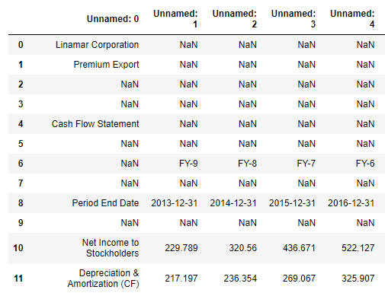
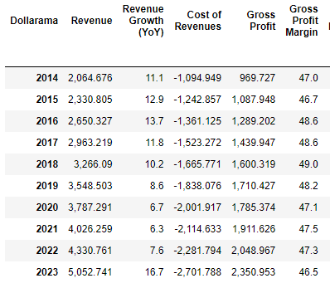
Data exploration and cleaning:
Steps taken to explore and clean the data obtained.
Challenges encountered during data preparation.

Slide 6
Analysis Process:
The methodologies utilized for financial ratio exploration, risk assessment, and company performance comparison.
Liquidity Ratios.
Risk Analysis Ratios.
Profitability Ratios.
Efficiency Ratios.
The time series analysis techniques were adopted for visualizing financial indicators' trends.
The analysis period spanned nine years from 2013 to 2022.

Slide 7

Analysis Process:
Converting columns from object type to uniform numerical.
Creating DataFrames for comprehensive insights.
Imported market stock price data using API tool.
Merging diverse DataFrames.
Employing regression models for predictive insights.

Slide 8
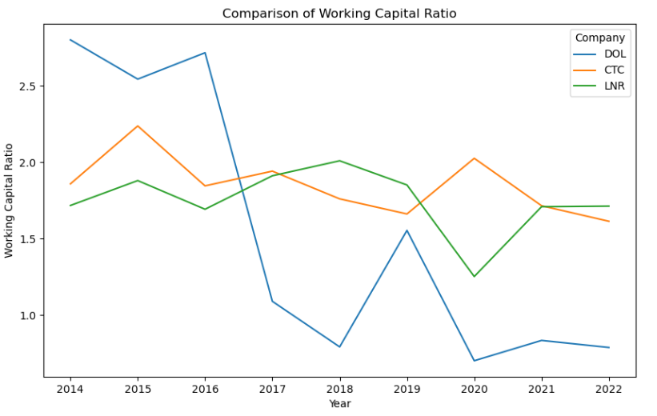
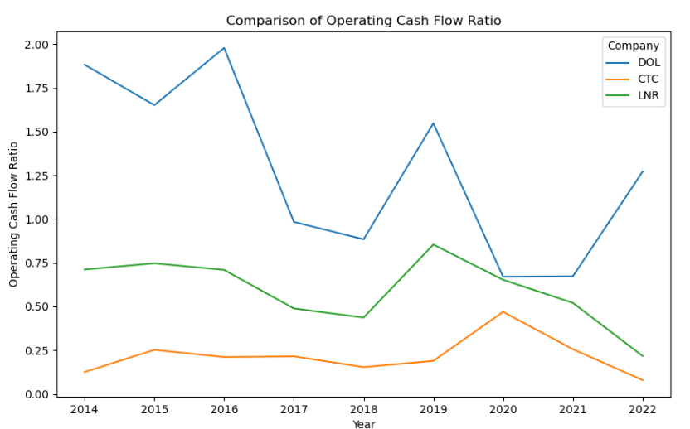
data visualization:
Make a comparison between companies based on financial ratios.

Slide 9
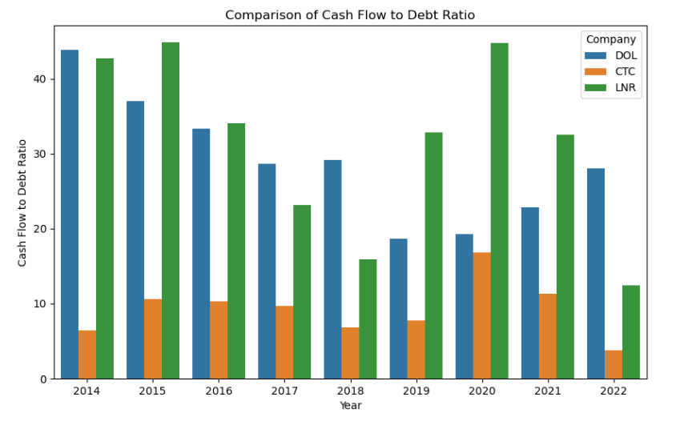
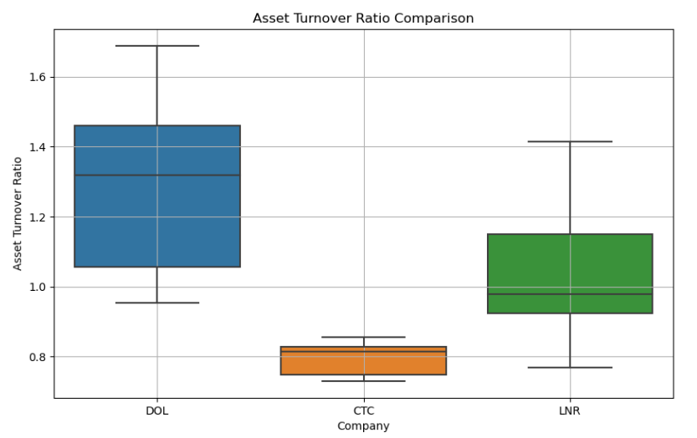
data visualization:
Make a comparison between companies based on financial ratios using different types of charts.

Slide 10
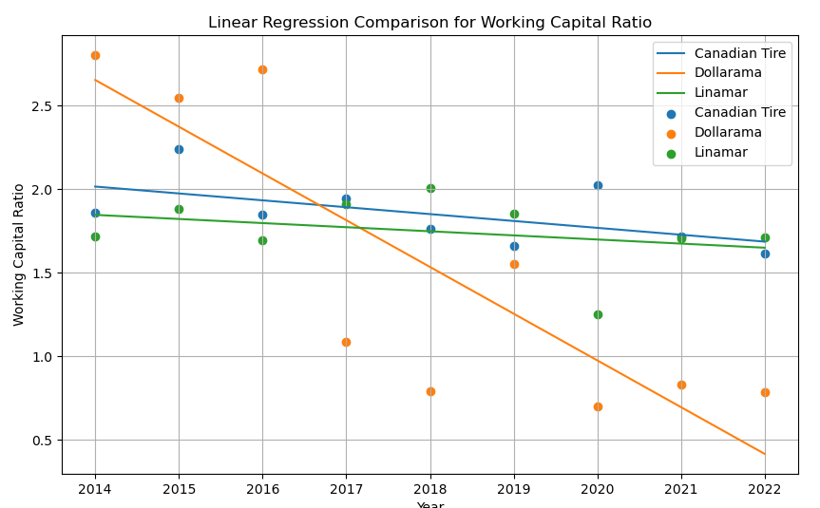
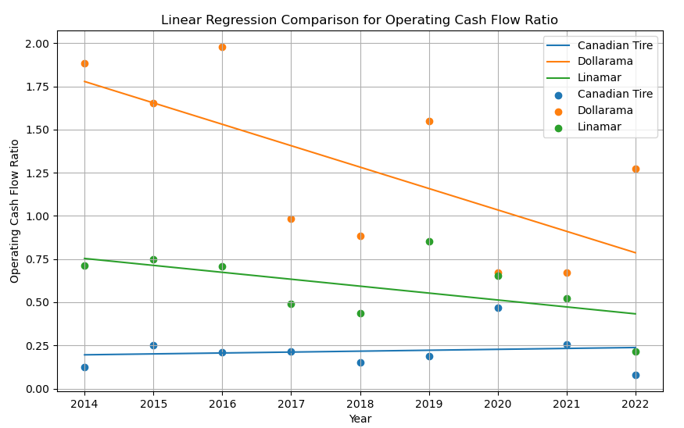
data visualization:
Make a comparison between companies using linear regression.

Slide 11
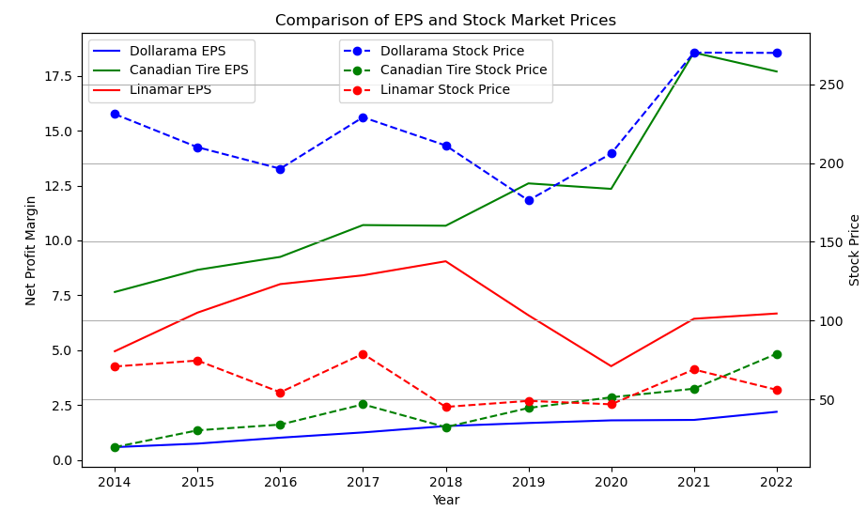
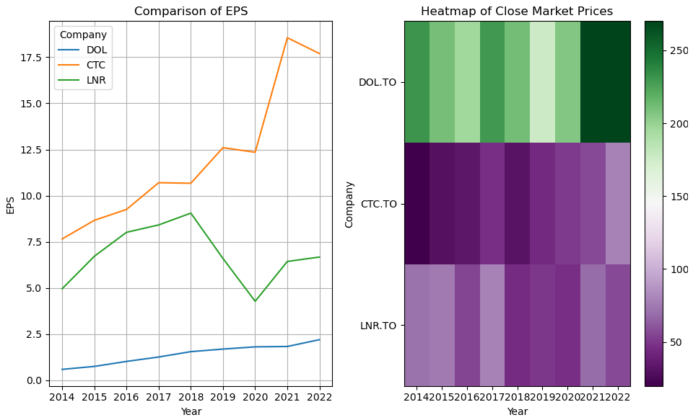
data visualization:
Make a comparison between Comparison by EPS and stock market prices

Slide 12
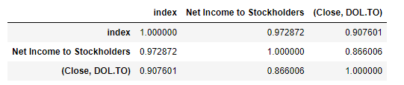
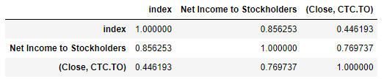
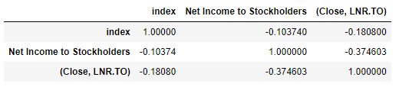
data visualization
Correlation coefficient analysis.

Slide 13
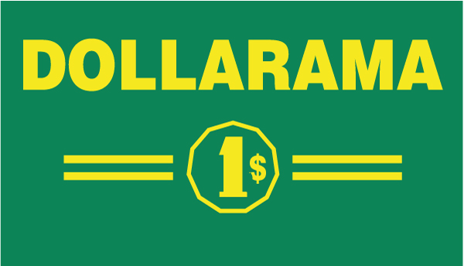
Conclusions and Summary:
Dollarama
Financial Ratios Overview:
Liquidity: Working Capital & Quick Ratios fluctuated, indicating short-term liquidity variations.
Cash Flow & Debt: Operating Cash Flow generally positive; Debt to Equity fluctuated, signaling changes in capital structure.
Profitability: Consistent Gross & Net Profit Margins; Stable Return on Equity (ROE).
Efficiency: Improvements in Inventory Turnover; Fluctuations in Asset Turnover.
Time vs. Operating Cash Flow Ratio:
Linear Regression Model: Negative relationship between time ('index') and Operating Cash Flow Ratio.
Equation: Operating Cash Flow Ratio = 251.35 - 0.124 * index
Indicates a predicted decrease in Operating Cash Flow Ratio with time.
Slide 4: Market Correlations

Slide 14
Conclusions and Summary:
Dollarama
Correlation Analysis:
Strong positive correlation between 'Net Income to Stockholders' and 'Stock Market Price' (Close, DOL.TO).
'Net Income to Stockholders' highly related to time ('index').
Slide 5: Conclusion & Recommendations
Insights & Suggestions:
Company shows consistent profitability but fluctuating liquidity and efficiency.
Suggested Focus Areas: Short-term liquidity management, Asset utilization efficiency.
Further Analysis: Benchmarking against industry standards for a comprehensive evaluation

Slide 15
Concluding remarks:
Main take:
The project gave good results using the tools that were studied.
The results helped answer most of the questions.
Future steps:
Work on comparing results with more companies from the same sector.
Using correlation models with the Canadian stock market index S&P/TSX Composite and sector index.
Analysis of the most important elements affecting the company's market price.

Slide 16

Question and Answers

